Slide 1
Waste Management System
September 9th 2011
Sydney Do

Slide 2
Decomposition

Slide 3
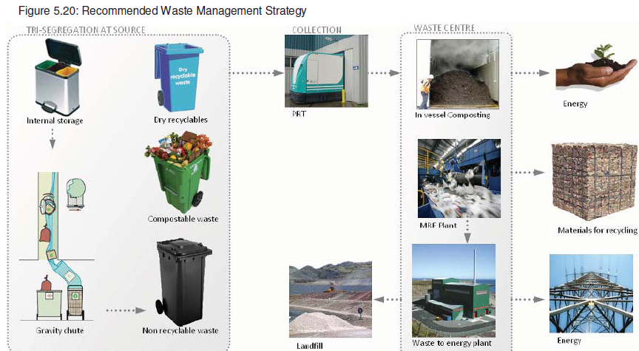
Masdar Waste Management System (WMS) Summary
Wet Recyclables
Dry Recyclables
Non- Recyclables & Hazardous Waste
Architecture is based on treating three broad classifications of waste
Wet Recyclables, Dry Recyclables, and Non-Recyclables and Hazardous Waste
Choice of Waste Management Process is driven by:
Waste content and its collection architecture (degree of pre-sorting)
Desired products of waste management process
Notes:
Choice of processing plant is driven by content of waste, its collection architecture, and the ultimate output desired from the waste management system.
Eg. Waste sorted at the source results in less requirement for sorting, thereby making materials recovery more attractive
Eg. Composting requires organic material

Slide 4
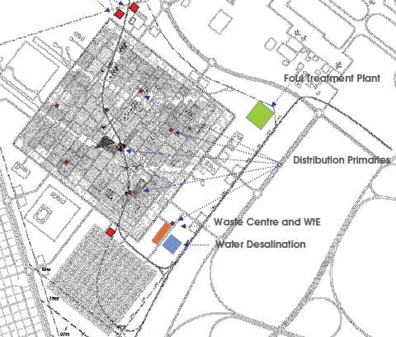
Masdar Waste Management System Summary (Cont)
For the case of Masdar, all waste management will be located within the Waste Centre and the Waste to Energy Facility
Materials Recovery Facility (MRF Plant) – Sorting for recoverable materials (recyclables), refuse derived fuel (RDF), and paper and plastic derived fuel (PPDF)
Biological treatment (composting and biogasification)
Thermal treatment (burning non-recyclable waste, RDF, and PPDF to recover energy)
Only spatial component of waste management system modeling occurs with the collection of waste

Slide 5
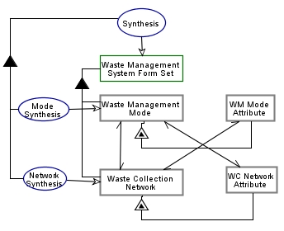
WMS Decomposition
Synthesis Template
Central Sorting
Biological Treatment
Anaerobic Treatment
Anaerobic Digestion
Thermal Treatment
(Waste to Energy)
Landfill
Waste Transportation System
Waste Collection System
Central Collection Site
Low Density Materials Banks
High Density Materials Banks
Street Side Containers
Kerbside Collection
Notes:
Waste Management System Form Set consists of Waste Management Mode and Waste Collection Network. Waste Management Mode exhibits WM Mode Attribute. Waste Collection Network exhibits WC Network Attribute. WC Network Attribute and Waste Management Mode are equivalent. Waste Collection Network and Waste Management Mode are equivalent. Waste Collection Network and WM Mode Attribute are equivalent. Synthesis consists of Mode Synthesis and Network Synthesis. Mode Synthesis yields Waste Management Mode. Network Synthesis yields Waste Collection Network. Synthesis yields Waste Management System Form Set.

Slide 6
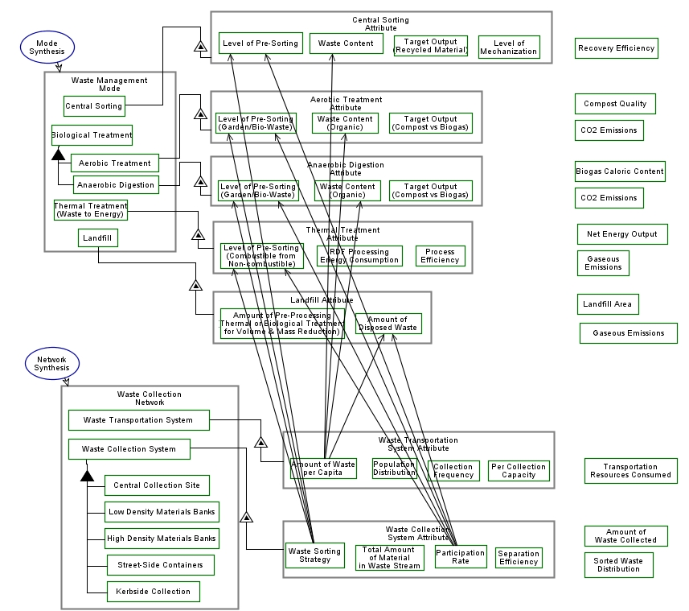
Waste Management Synthesis
Notes:
Note that these processes are heavily reliant on the collection architecture, the waste content and the target output
Examples for target output include PPDF or recycled plastic and paper
Listed to the right are some of the fixed parameters which drive the performance of each process

Slide 7
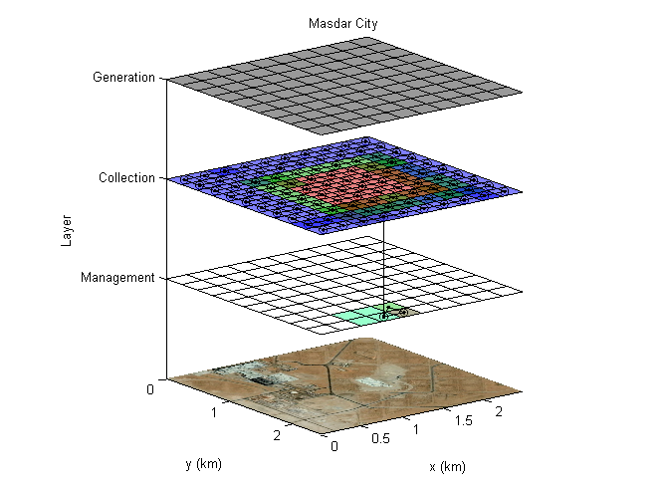
Waste Management System Synthesis Interactions with other Subsystems
Driven by Building System
Driven by Transportation System
Consumes energy, water, land
Thermal Treatment
Central Sorting Facility
Biological Treatment
To Energy Generation Layer

Slide 8
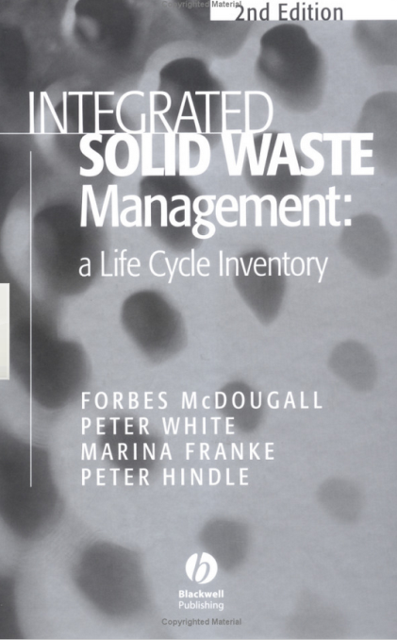
Waste Management System Model DSM
 | Land Consuming | Transportation Consuming | Energy Consuming | Water Consuming | Total Residential Waste | Total Commercial Waste | Total Delivered Waste | Waste Collection | Waste Sorting | MRF Sorting | RDF Sorting | Biological Treatment | Thermal Treatment | Landfill | Materials | Energy Generating
Land Consuming
Transportation Consuming
Energy Consuming
Water Consuming
Total Residential Waste
Total Commercial Waste
Total Delivered Waste
Waste Collection |  | 1 | 1 |  | 1 | 1 | 1
Waste Sorting | 1 |  | 1 | 1 |  |  |  | 1
MRF Sorting | 1 |  | 1 | 1 |  |  |  |  | 1
RDF Sorting | 1 |  | 1 |  |  |  |  |  | 1
Biological Treatment | 1 |  | 1 | 1 |  |  |  |  | 1 |  | 1
Thermal Treatment | 1 |  | 1 |  |  |  |  |  | 1 | 1 | 1 | 1
Landfill |  |  | 1 |  |  |  |  |  | 1 | 1 | 1 | 1 | 1
Materials |  |  | 1 |  |  |  |  |  | 1 | 1 | 1 | 1 | 1
Energy Generating |  |  |  |  |  |  |  |  |  |  |  |  | 1 | 1
Model based on IWM-2 developed by McDougall et al. (commonly referenced model in the literature)

Slide 9
Formulation

Slide 10
MRF Sorting
Determine input MRF Waste Stream based on:
Waste input and waste collection for residential (both kerbside and materials banks) and commercial sources
Contamination rates, both from organic and “other” sources
Note that stream is divided into the defined categories of waste (ie. paper, glass, ferrous metals, non-ferrous metals, film plastic, rigid plastic, textiles, organics, other)
Determine residue based on contamination rates
Determine resulting MRF output based on difference between input and residue
4. User has option to determine the destination for outputs
For glass, metal, textiles – either recycle or landfill
For paper and plastic – either recycle, burn for energy recovery, or landfill
5. User can determine whether residue post-sorting is either incinerated or landfilled

Slide 11
RDF Sorting
For both Coarse RDF (cRDF) and Densified RDF (dRDF)
Determine restwaste available to c/d-RDF sorting:
Based on combined residential and commercial restwaste, % of waste rejected due to lack of capability of plant (2% default value), and % of waste considered to be rogue items which cannot be treated (2% default value)
User chooses % of restwaste dedicated to developing c/d-RDF
Amount of c/d-RDF based on published content:
User has option to determine % of fines that are biologically treated vs being sent to landfill
User inputs energy requirements for RDF production (energy bookkeeping), transportation distance to landfill/biological treatment plant (emissions bookkeeping), and costs of processing and of market value of recovered metals (cost bookkeeping)
RDF content
Can be further extracted
for recycling
Process Outputs for cRDF (Table 18.6 of Textbook) Source: ETSU (1992;1993b)
 | Paper | Glass | Ferrous Metal | Non-fe Metal | Film Plastic | Rigid Plastic | Textiles | Organics | Other
Fuel (%) | 89.5% | 28.7% | 7.6% | 31.5% | 83.6% | 89.3% | 80.7% | 42.7% | 36.5%
Ferrous Metal (%) | 0.0% | 0.5% | 86.7% | 0.0% | 0.0% | 0.3% | 0.8% | 0.6% | 0.2%
Non-fe Metal (%) | 0.0% | 0.0% | 0.0% | 50.0% | 0.0% | 0.0% | 0.0% | 0.0% | 0.0%
Fines (%) | 8.8% | 70.5% | 4.0% | 17.1% | 4.5% | 8.8% | 4.1% | 56.2% | 61.5%
Residue (%) | 1.7% | 0.3% | 1.7% | 1.4% | 11.9% | 1.6% | 14.4% | 0.5% | 1.8%
Total (%) | 100.0% | 100.0% | 100.0% | 100.0% | 100.0% | 100.0% | 100.0% | 100.0% | 100.0%
Can either be biologically treated or landfilled

Slide 12
Biological Treatment
Determine biological stream input based on:
Waste input from biowaste bins/bags and waste collection for residential (both kerbside and materials banks) and commercial sources
Plastic contamination rates from biowaste bins/bags (default value of 5%)
Fines and residues from c/d-RDF sorting process and amount user specified to be diverted to biological treatment (see previous slide)
In addition, a % of the restwaste stream can be added to the biological waste stream. This is user defined
Total Material Available for Biological Treatment is then calculated by summing the material available from biowaste bags/bins, c/d-RDF fines and residues, and restwaste
4. User has option to determine the proportion of each type of biological treatment employed:
Composting (aerobic digestion)
Biogasification (anaerobic digestion)
Remainder (if any) is assumed to go to landill
5. Amount of compost and biogas produced is based paper and organic fraction of input stream:
(Paper + organic input) * biological process mass loss %
Composting % mass loss is assumed to be 50%
Biogasification % mass loss is assumed to be 60% (higher due to need to press and digest material to remove excess moisture prior to composting)

Slide 13
Thermal Treatment
Determine thermal stream input based on:
Restwaste from sorting sent for thermal treatment
Residues from MRF and biological treatment sent for thermal treatment
RDF and PPDF extracted from sorting
Energy output calculated based on amount of each waste fraction
Uses fixed values for:
Caloric content
Non-hazardous and hazardous residue content
Ferrous metal fraction
of each waste fraction
3. Same concept employed for PPDF and RDF burning
 | Paper | Glass | Ferrous Metal | Non -fe Metal | Film Plastic | Rigid Plastic | Textiles | Organics | Other | Compost
Cal value (GJ/tonne) | 10.5 | -0.5 | -0.5 | -0.5 | 25 | 28 | 13.5 | 3.7 | 4 | 7.4
Solid Residues
(tonnes/tonne input) | Paper | Glass | Ferrous Metal | Non -fe Metal | Film Plastic | Rigid Plastic | Textiles | Organics | Other | Compost
Hazardous* | 0.032 | 0.032 | 0.032 | 0.032 | 0.032 | 0.032 | 0.032 | 0.032 | 0.032 | 0.032
Non-hazardous** | 0.084 | 0.9 | 0.85 | 0.9 | 0.09 | 0.06 | 0.075 | 0.077 | 0.42 | 0.154
*Includes fly ash, filter dust, and gas cleaning residues. This assumes that for each tonne of MSW incinerated, 20kg of filter dust and 12kg of sludge residues from the gas-scrubbing system are produced (their sum is 32kg/T) ** From bottom ash REF: Barton J., 1986, "The Application of Mechanical Sorting Technology in Waste Reclamation: Options and Constraints"

Slide 14
Code Demonstration

